Slide 1

TOO LATE TO REGRET

Slide 2



Her teacher praised her for her sincerity. She always submitted her work on time and was good in extracurricular activities as well .
Once upon a time there lived a girl named Samaira with her mother and father. She was a brilliant child and well mannered.

Slide 3


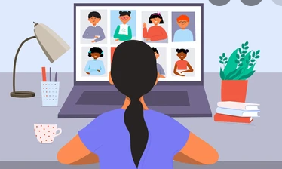
So, the government ordered lock down, as a result Samaira was unable to go to school. However, started with online classes from home on mobile or laptops.
Suddenly, it was reported that a virus outbreak a global health emergency , due to which pandemic was declared.

Slide 4


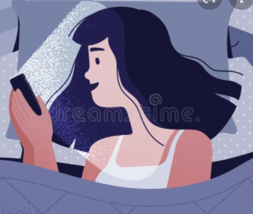
She started exploring more internets and got diverted into online games and videos.
In no time she got distracted from her studies and started spending hours and hours on mobile games.

Slide 5


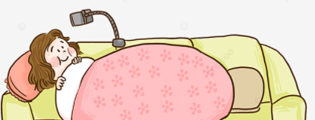



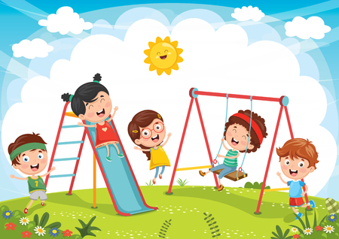
She never completed her homework nor concentrated in the class, rather ignored teachers. She also started lying to her parents when they asked about her studies.
She stopped going outside to play with her friends in the neighbour and said them that she had studies to complete.

Slide 6


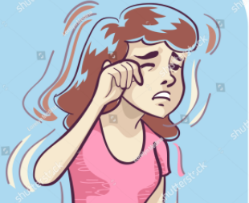
Soon pandemic was over and everything was going good. Samaira started going back to her school and realized that
she was having problem with her eyes. She was unable to see the blackboard.

Slide 7

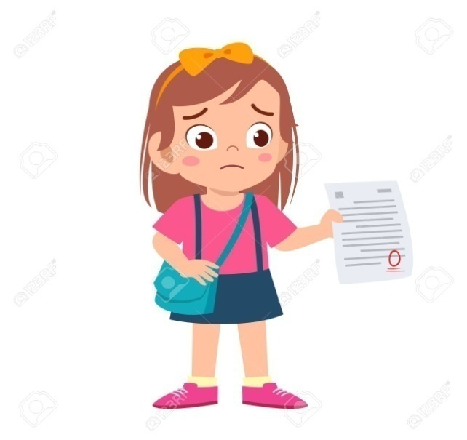
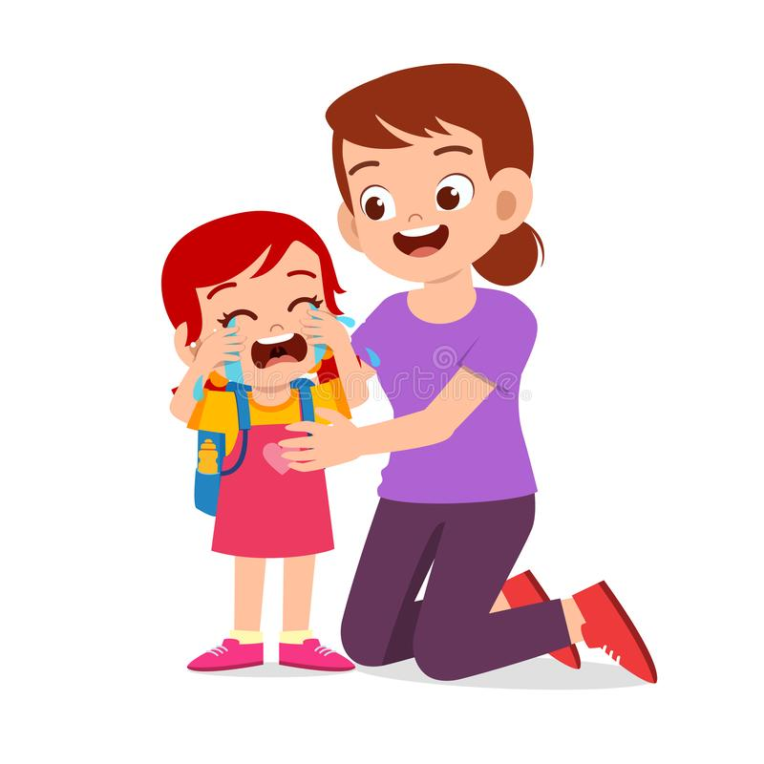
Also she drastically failed in her exams. All her years earned reputation in her school became worthless. She realized her mistakes and
cried a lot. Her parents supported her and advised her to be attentive and sincere again also to not use mobiles at all.

Slide 8
Moral Of The Story…………
AS YOU SOW, SO YOU REAP.

Slide 9

Thank You ☺
By, Trayi Pattanayak Anushka Singh Angeleena Rozario Sujan Mondal
Afifah Islam Subhoshree Saha

Slide 10

QUESTIONS
A) Why was pandemic declared?
B) What did she studied through during lock down?
C) After going back school what did she realized?
D) Why did she cried at the end of the story?
E) What did you learn from the story?

